Slide 1
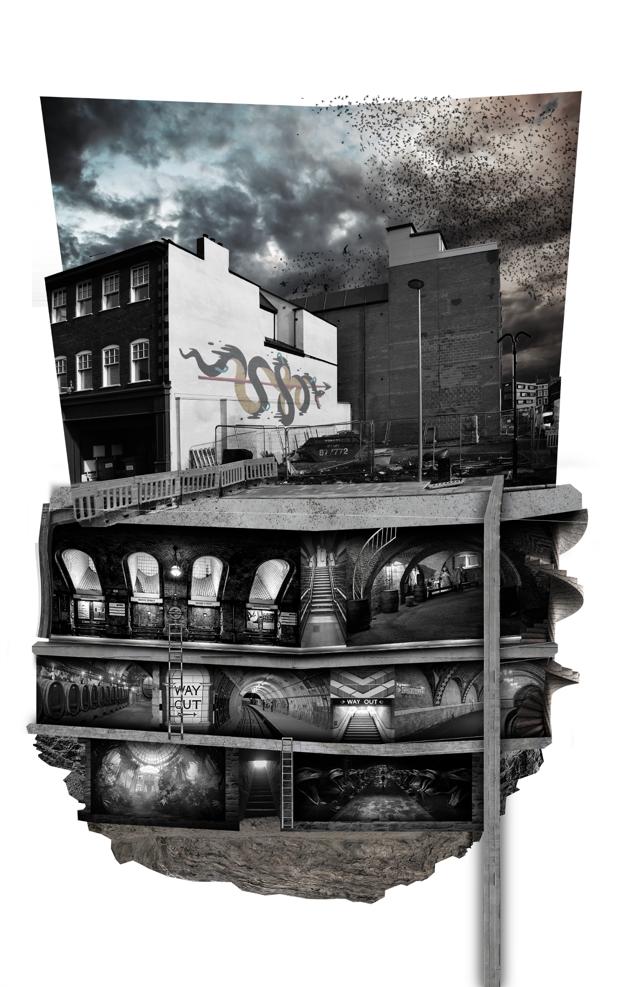
ABOVE GROUND [SHOP]
SERPENTINE’S STUDY
STAIR
STABLE
CELLAR
DINING ROOM
STAIR
RECEPTION ROOM
REPTILE ROOM
STAIR
CHAMBER OF SECRETS

Slide 2
Dungeon
Cellar
Stable
Kitchen
Pantry
Freezer
Snake Pit
Reptile Room
Reception Room
Dining Room
Serpentine’s Study
Dress Closet
Room of Indulgence
Bedroom
sHOP
Staff Quarters
Terrace
Chamber of Secrets

Slide 3
Dungeon
Cellar
Staff Quarters
Kitchen
Pantry
Freezer
Stable
Snake Pit
Chamber of Secrets
Reptile Room
Serpentine’s Study
Dress Closet
Room of Indulgence
Bedroom
Terrace
Reception Room
Dining Room
Shop
Stock Room
Staff Slums
Lower Ground
Serpentine’s Quarters
↖ BELOW GROUND
ABOVE GROUND ↘
Above Ground

