Slide 1
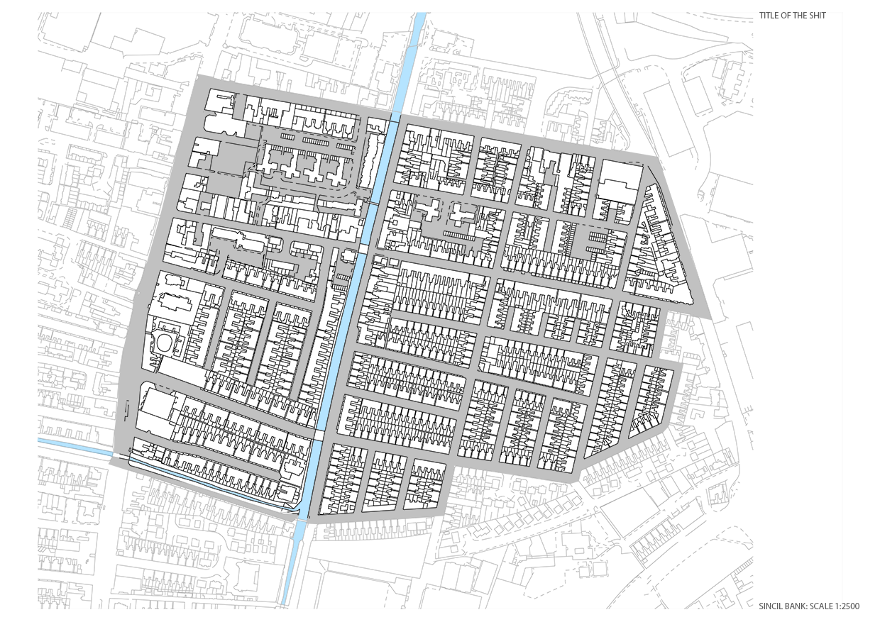
1: MOVEMENT STRUCTURE
The Graph to the right shows the number of people and cars on select streets within sincil bank. As you can see on the ….
Below is an Axial map of Sincil Bank. The colours of the lines represents the connectivity of each street. Red streets are well connected and blue streets are not so well connected. Streets that are well connected provide opportunity for social capital by providing means for repetetive interaction. However the neighbourhoods need to be walkable for this to occur. Walkable neighbourhoods have well connected streets with short and direct routes; contributing to the presence of people on the streets. This creates a sense of community through repeatable random interaction.

Slide 2
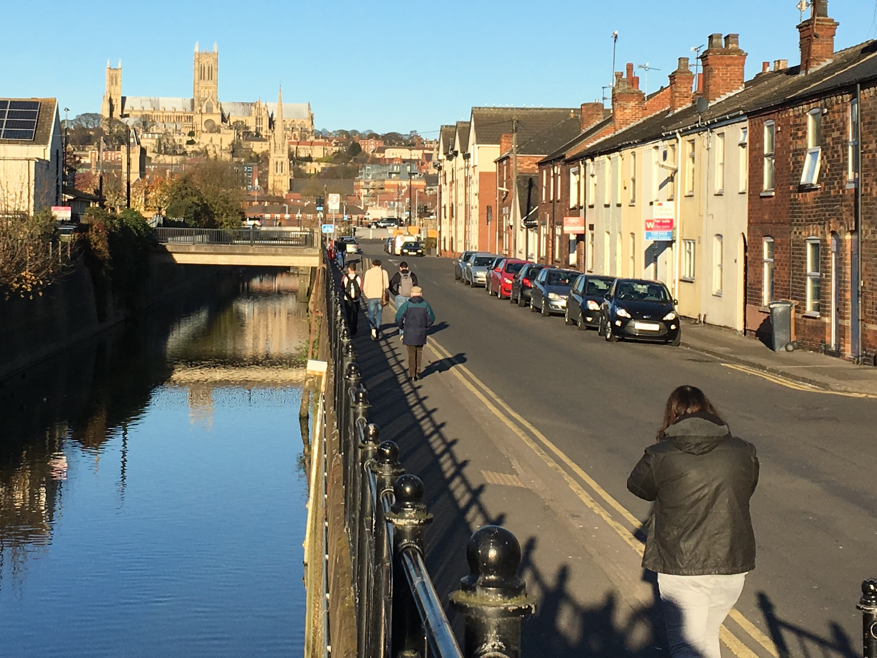
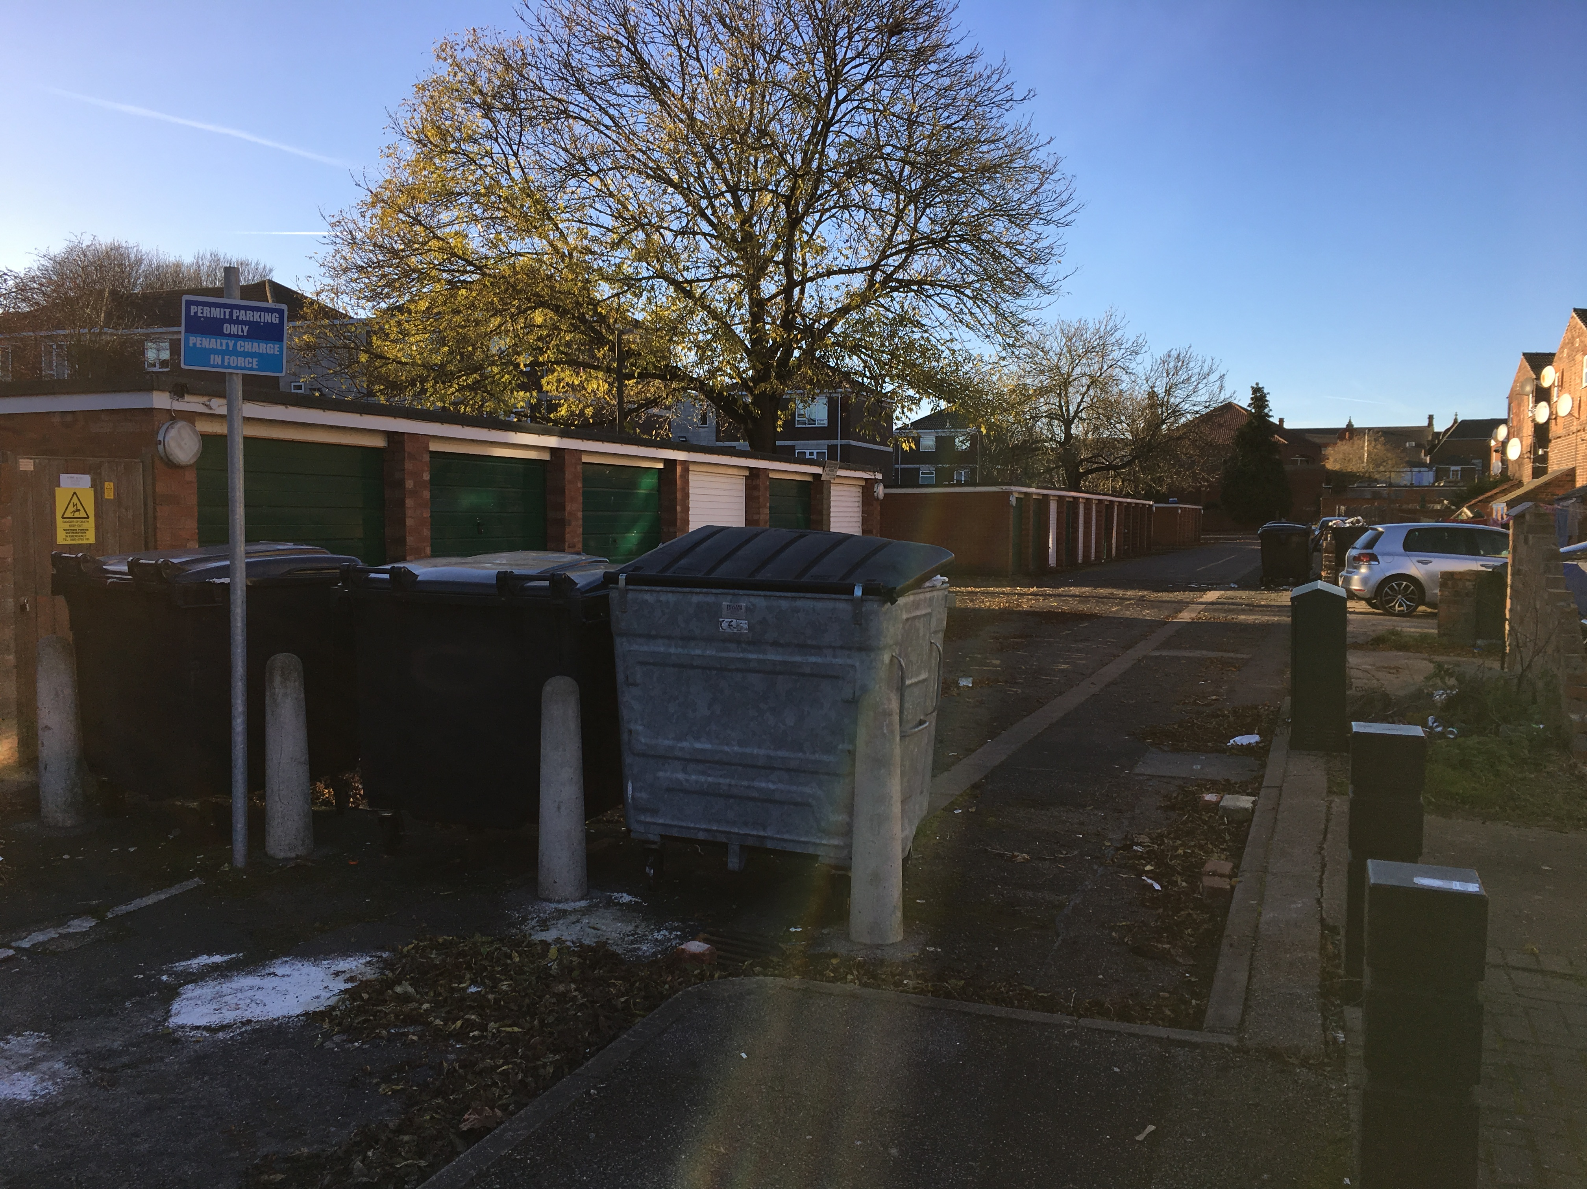
1: MOVEMENT STRUCTURE
Sincil bank has a lot of potential to be a walkable neighbourhood As you can see below there is an efficient grid layout of footpaths, however these are underutilised due to the lack of facilities in the immediate area. People are forced to use cars to access basic facilities such as shops, schools and community centres. Car dependence reduces social interaction and thus reduces social capital. [1] The images to the right show two streets in sincil bank. The well connected one has a view of the cathedral, facilities dotted along it and is bustling with people; providing an opportunity for interaction for all the surrounding residents. The disconected street however is dark and uninviting. There are trash bins blocking the main entrance and it is very dirty. This area is seldom used by anyone who isnt in the immediate area and has been neglected.
Fig. X An example of a well connected, walkable street.
Fig. X An example of a disconnected, uninviting close
Pathways Map

Slide 3
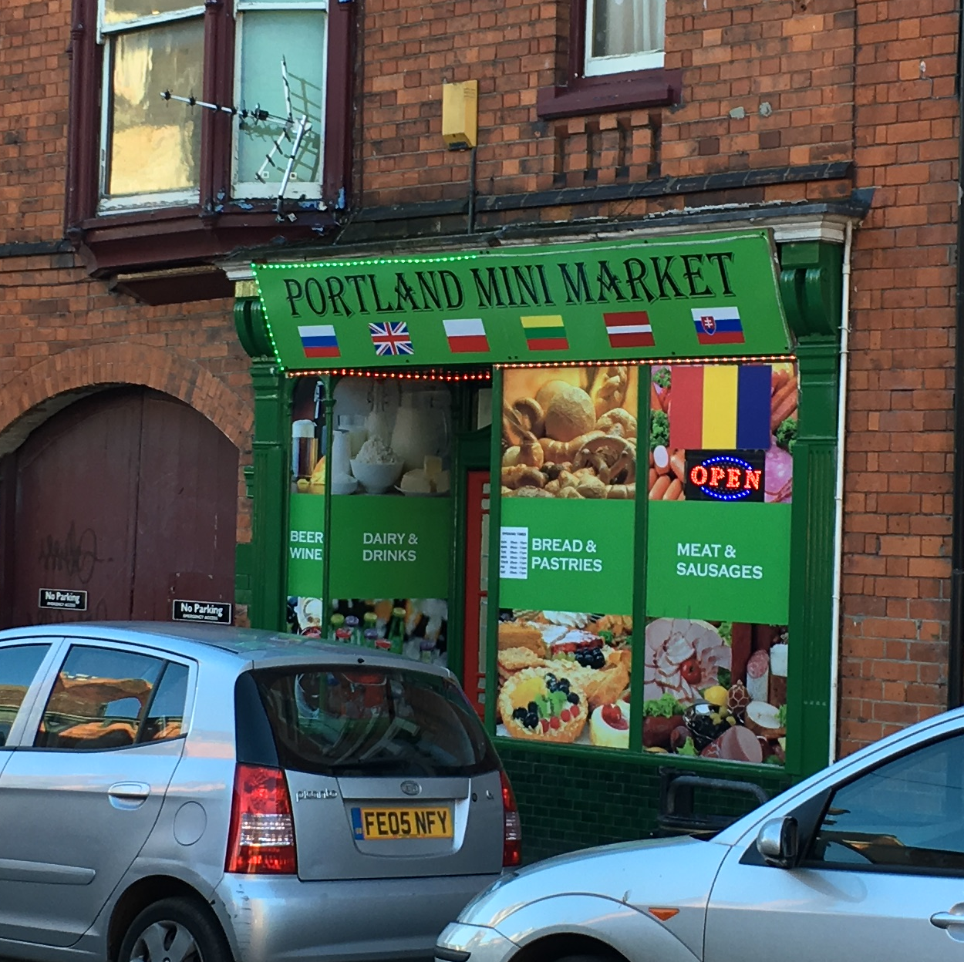
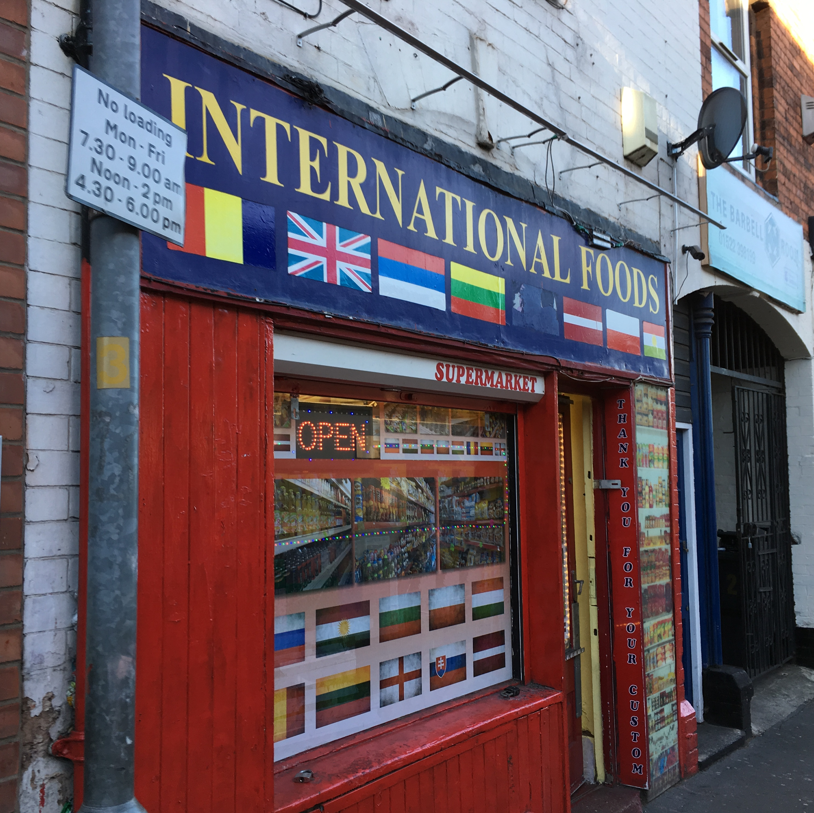
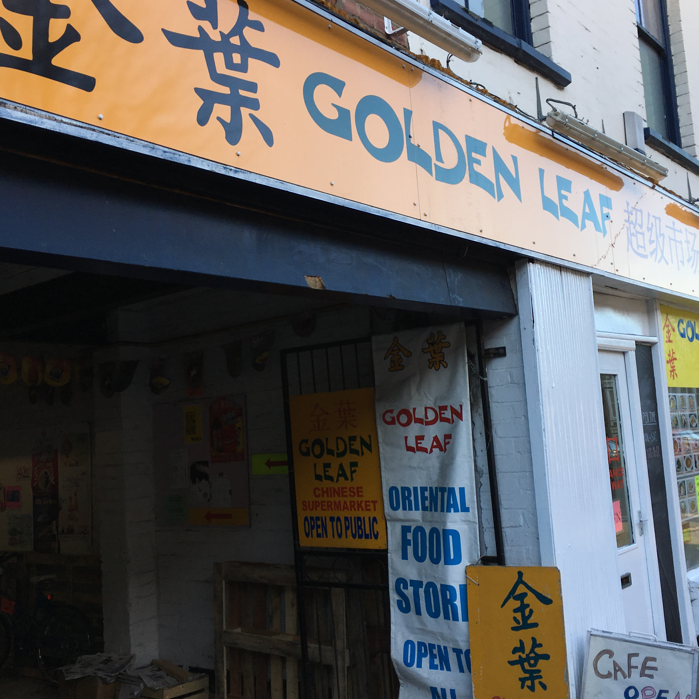
2: MIXED USE
The three images above are from Portland Street, a well connected street to the north of Sincil Bank. There is a good range of shops targeted towards different ethnic groups: Portland Street is a good example of a mixed use street; This will foster community and build social capital. On the other hand, the rest of Sincil Bank is different. Any corner shops that do exist are mostly targeted towards Polish residents. This diversity is good, however the large proportion of Polish shops may isolate other ethnic groups, causing them to use cars to visit their preferred shops, lowering the walkability of the area for certain people.
Land Use + Walking Distance map

Slide 4
2: MIXED USE
The Urban design Guide notes that a variety of commercial and community facilities should be accessible of foot to encourage people to use them. Apart from Portland street, Sincil Bank is not a very mixed use area. Local schools, supermarkets and other community facilities are all located out of area. This is not such a problem for those who live to the North West of Sincil Bank, as the lower high street provides a lot of these facilities along with employment opportunities, but

